Slide 1

Enhancing Global Financial Operations with a Distributed Database Management System
A Strategic Proposal for My Company
Gordon Elliott Williams, P10026108
BIA550-30 BUSINESS INTELLIGENCE AND ANALYTIC SYSTEMS
POST UNIVERSITY
06/19/2025

Slide 2

The Challenge: Why A New Database?
Our remote financial services for international businesses face growing hurdles with a central database:
Slow Data Access: Clients and teams worldwide experience delays.
Single Point of Failure: One outage stops everything.
Scalability Limits: Hard to grow with more international clients.
Data Sovereignty: Difficulty meeting varying country-specific data laws.

Slide 3
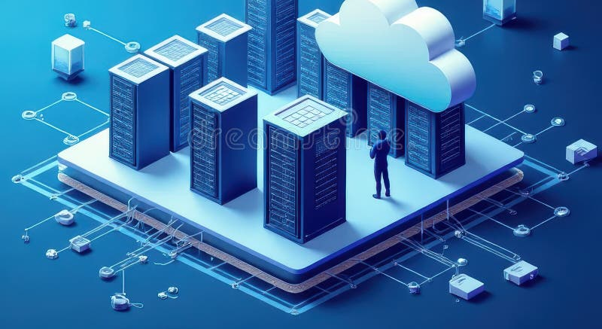
Solution: Distributed Database Management System
A DDMS spreads our data across multiple interconnected servers globally.
Definition: Like having separate libraries for different parts of our "financial records book" (data) in various cities.
Key Benefit: Data is closer to users, improving speed and reliability.
How it Works: Data can be "fragmented" (split) by region

Slide 4
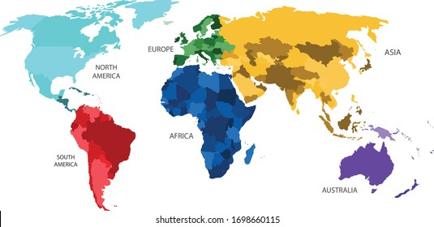
DDMS & Data Fragmentation: Faster Access
Data Fragmentation is strategically splitting our data.
Horizontal Fragmentation (by region): Storing European client data on a European server, Asian data on an Asian server.
Advantage: Our regional teams (e.g., Accounts Payable in London) get super-fast access to relevant client data.
Impact: Speeds up daily operations and compliance with local data laws.

Slide 5

DDMS & Predictive Analytics: Smarter Decisions
A DDMS powers better forecasts:
Local Predictions: Analyze regional data faster to predict things like late payments for European clients specifically. This allows for targeted, proactive actions.
Global Insights (with care): Combine data from all regions for overarching trends (e.g., global cash flow forecasts), though this requires careful data aggregation.
Ethical Consideration: We must ensure privacy and legal compliance across all regions when using data for predictions.

Slide 6

DDMS & Transparency: Building Trust
Internal Transparency:
Faster Info: Our teams quickly access their regional data, improving efficiency and client responses.
Unified View (with design): Management can still get consolidated global reports.
External Transparency:
Faster Client Portals: Clients get quicker access to their data from nearby servers.
Enhanced Security/Privacy: Demonstrates commitment to local data regulations

Slide 7

Summary
A DDMS is a strategic investment to future-proof our global financial services.
It's crucial for speed, resilience, and compliance.
It allows us to better serve our international clients and leverage data for smarter decisions.
Next Steps:
Detailed technical architecture planning.
Phased implementation strategy.
Pilot project selection and execution.

Slide 8

Thank You
Gordon Elliott Williams
Gordon.Williams@student.post.edu

